Slide 1

Wellesley college integration hub
Workato automation impact award submission
Education, non-profit and government
March 21, 2022

Slide 2

Wellesley college integration hub
Brings together Wellesley Student, Faculty and Staff data
Enables Integration in Wellesley’s Modern Hybrid Environment
Cloud data sources include Workday Human Capital Management (HCM), Workday Student and Salesforce
On premise data sources include SQL Server and MySQL
Used for Integrations with numerous downstream Applications

Slide 3
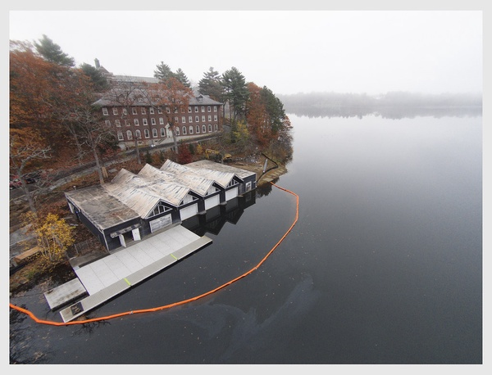
Wellesley college integration hub
Workato recipes pull source Student, Faculty and Staff data
Workato recipes combine, transform and / or push data to target systems / applications
Workato recipe functions (callable recipes) used extensively to encapsulate logic for use across multiple recipes / integrations
Emails and SMS communicate job status to administrators

Slide 4
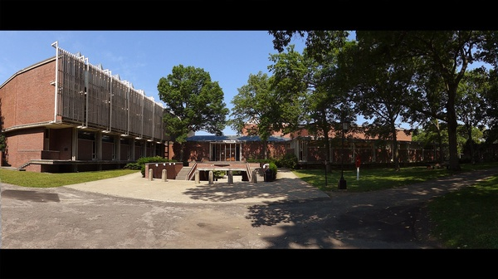
Wellesley college integration hub
Well Known Higher Education Target Applications Include
StarRez (Housing)
Presence (Campus Engagement)
Sakai (Learning Management)
TutorTrac
International Student and Scholar Management (ISSM)
Accessible Information Management (Disability Services)
Barnes and Noble College Adoption and Insights Portal (AIP)

Slide 5

Wellesley college integration hub
API Based Integrations (Current)
Workday Finance (Gifts and Pledges)
Qualtrics (Surveys)
College Board (SAT)
ACT
API Based Integration (In Progress)
FOLIO (Library Management)

Slide 6

Wellesley college integration hub
Tangible Benefits of Using Workato (ROI)
Key Component of Integration Strategy in Move from On Premise ERP to Cloud Based, Best-of-Breed Services for Students, Faculty, Staff and Alums
Very Small On Premise Footprint (Agent) Supports Integration with On Premise Resources in Wellesley’s Hybrid Environment
Unified Cloud Based Interface Eliminates Barriers to Recipe Development, Deployment, Scheduling, Execution and Management
Self Documenting, Flowchart Style Recipes Enable Integration Development and Maintenance by Small IT Staff and Technical Business Analysts

